Slide 1
Session 3: Assessment for Learning

Slide 2
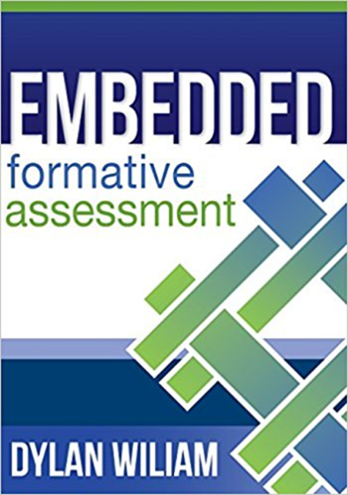
Assessment for Learning is also known as Formative Assessment. One of the greatest proponents of Formative Assessment is Dylan Wiliam.
“The basic idea behind formative assessment is that evidence of student learning is used to adjust instruction to better meet students’ learning needs – in other words, teaching is adaptive to student needs” Wiliam, (2011).

Slide 3
The 5 Strategies of Formative Assessment/
Assessment for Learning
1. Clarifying, sharing, and understanding learning intentions and criteria for success
2. Eliciting evidence of student learning
3. Providing feedback that moves the learning forward
4. Activating learners as instructional resources for one another
5. Activating learners as the owners of their own learning
Wiliam, D. (2011). Embedded Formative Assessment. Solution Tree Press.

Slide 4
1. Clarifying, sharing, and understanding learning intentions and criteria for success
 | Define | Give an Example
Learning Intention/objective | A learning intention is what you are planning that the students will learn in the lesson or series of lessons. WALT: What we are learning today | Know ways of controlling floods
Learning Context | Applying to a context | Bangladesh
Criteria for Success | Success criteria are a selection of the most important things that students need to demonstrate to show they have achieved the learning intention. WILF: What I am looking for | A list of different causes of flooding An explanation of how flooding could be reduced in each case A list of recommendations for how people could cope with floods Comparisons with flooding in England.
https://webcontent.ssatuk.co.uk/wpcontent/uploads/2016/11/24142101/TLC2_2_1.pdf

Slide 5
Why is clarifying learning intentions important?
Students understand the “Why”
Students know what is expected of them
Students can engage with the learning intentions so that they can evaluate their learning
Students understand what quality work looks like as they understand the criteria
Students engaged in discussion about the learning intention
How do you communicate these to your learners?
Give students time to think about and discuss amongst their peers the learning intentions
Wiliam, D. (2011). Embedded Formative Assessment. Solution Tree Press.

Slide 6
2. Eliciting evidence of student learning
We elicit evidence of students’ learning to assess students where they are in their learning:
Their starting point
If they have an understanding of the content before moving on
It highlights to us as teachers if we have to revisit the material
Eliciting evidence can take place at any point in the lesson.
“There are really only two good reasons to ask questions in class: to provide information for the teacher about what to do next (to reveal student thinking as described above) or to cause thinking” Wiliam, (2011).
This shouldn’t be about creating more marking for yourself.

Slide 7
3. Providing feedback that moves learning forward
Reflecting on the following factors. Will they provide students with effective feedback to move learning forward?
Giving students just scores
Giving students just constructive comments
Giving students scores and constructive comments
Praise
The timing when feedback is given
Scaffolded responses or a complete solution
Action orientated responses
Compare your thoughts with the research. Why might feedback lower a student’s performance? What might you need to consider?
Effective principles for providing feedback:
Feedback should be more work for the recipient
Feedback should be focused – less is often more
Feedback should relate to the learning goals shared with students
Wiliam, D. (2011). Embedded Formative Assessment. Solution Tree Press.

Slide 8
William, D. (2011). Embedded Formative Assessment. Solution Tree Press.
Factors that affect whether feedback is effective
Scores and Constructive Comments: In one study, students learned twice as fast when they received constructive feedback (specific comments on errors, suggestions to the students about how to improve, and at least one positive remark) than their peers who simply received a score on their maths homework. In another study, students who only received scores made no progress from one task to the next, while those students who received comments, improved about 30 per cent. This was not surprising. However, it was interesting that students who received both a score and comments also made no progress. The effect of giving them a score had wiped out the benefits of giving them comments! Those with the highest scores felt no need to read the comments and those with the lowest scores did not want to read the comments and yet this is the most common form of the feedback given to students in the United States.
Praise: In another study, giving written praise had no effect on achievement. In fact, it had the effect of having the students focus on their egos rather than their academic work.
Timing: The timing of feedback is also crucial. One study showed that if feedback is given too early, before students have time to work on the task, then they will learn less from the feedback. Furthermore, feedback is only useful if it is given with enough time for the student to use the feedback to improve his or her work. It is particularly helpful to give students time, in class, to use the feedback to improve their work. Remember that feedback only functions formatively if the information fed back to the learner is used by the learner in improving performance. If a teacher writes the following comment on a science assignment after it has been completed, it cannot be of use to the student, “You need to be more systematic in planning your scientific inquiries.”
Scaffolding: In one research study one set of students stuck on a problem received a scaffolded response – just the minimum amount of support to help them solve the problem. Another set of students were given a complete solution. When both sets of students had to solve another similar problem, the students who were given the scaffolded feedback learned more and retained more.
Action Oriented: Saying what’s wrong isn’t enough. The secret of effective feedback is to provide a recipe for future action. When feedback focuses on what is deficient without telling students how to move forward, this does not help the student. For example, when a teacher writes that a student’s thesis statement isn’t clear this is not very helpful. First of all, this would be a more useful comment during learning. Second of all, the student needs a recipe for how to make it clearer. It is not enough to simply point out the current state. Feedback must outline a series of scaffolded steps to bring the learner to the desired goal.

Slide 9
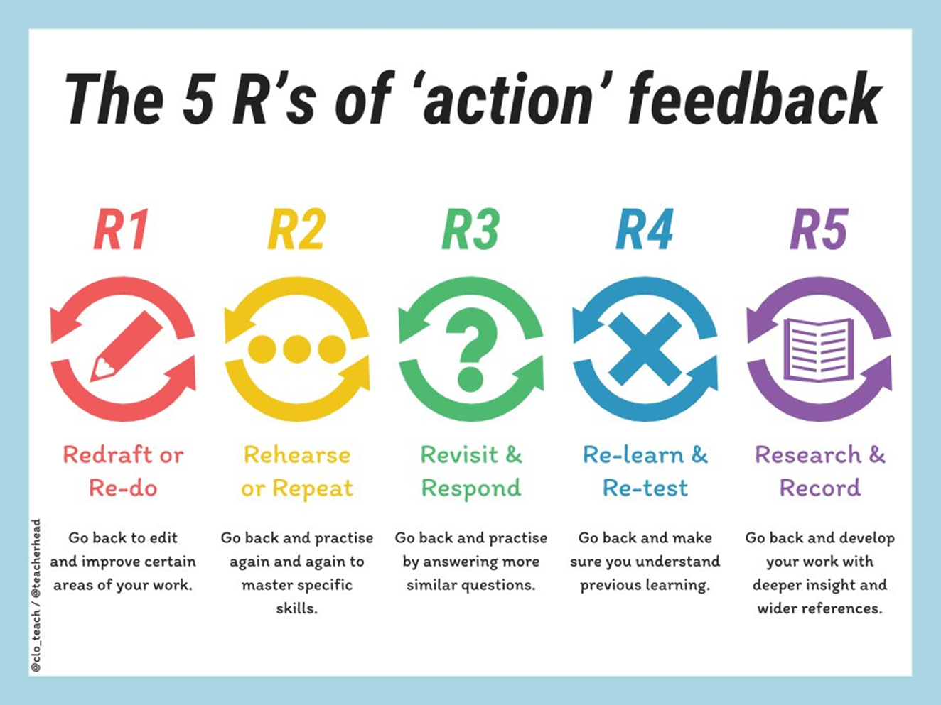
https://teacherhead.com/2017/12/18/fiveways-of-giving-effective-feedback-as-actions/

Slide 10
5. Activating learners as the owners of their own learning
Students giving peer feedback /tutoring or working collaboratively is very effective in raising student achievement.
The key features for cooperative learning are:
Group goals
Each student must be accountable
The skills that students develop so they are successful at self-assessment include:
Self Regulation (Combination of cognitive resources and emotions and actions)
- Cognitive resources (Knowledge, skills and strategies to reach the goal)
- Emotions and actions (Motivation and will to reach the goal)
Metacognition – Students recognise their cognitive resources and how to improve them
Motivation – Student motivation for learning (Make goals that are specific and in reach of the learner but always have some degree of the challenge)
Wiliam, D. (2011). Embedded Formative Assessment. Solution Tree Press.

Slide 11
The 5 Strategies of Formative Assessment
Don’t try to do all these in practice at once.
Pick one area to focus on and develop it until you are confident.
1. Clarifying, sharing, and understanding learning intentions and criteria for success
2. Eliciting evidence of student learning
3. Providing feedback that moves learning forward
4. Activating learners as instructional resources for one another
5. Activating learners as the owners of their own learning

